Slide 1
Project 5: Sleep Position Classifier
Massimo Alfonzo
Chloé Canavate
Patrick Franke
Tutor: Giulia Alessandrelli
Professor: Pietro Cerveri
Milan, 14 July 2022

Slide 2

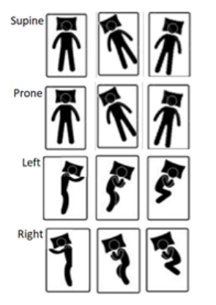

Introduction
Objective
Classify 12 distinct sleep positions based on data gathered from two accelerometers
Methodology
Using supervised and unsupervised machine learning techniques
M. Alfonzo, C. Canavate, P. Franke

Slide 3
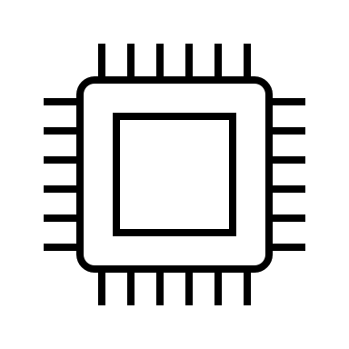
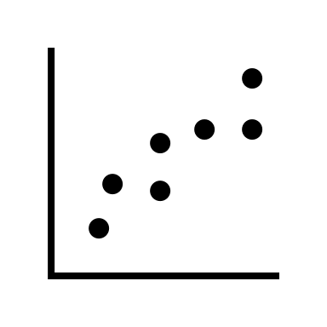






Project outline
Hardware & Firmware
set up
Data visualization
and acquisition
Machine Learning
Breadboard V1
3-axis accelerations acquisition
PCB design
Casing design
Acquisition improved using FIFO
Data transmission via Bluetooth
3D printing & wires preparation
Supervised classifier techniques
Unsupervised methods
Optimization of the parameters using CV
Prediction of the 4 master positions
Models comparison & best model selection
GUI development
for data acquisition
(12 positions)
Added live visualization of 6 acceleration channels
Data acquisition from 11 subjects
Visualization and pre-processing
M. Alfonzo, C. Canavate, P. Franke

Slide 4
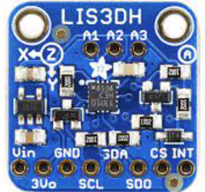
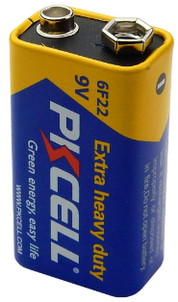
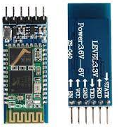
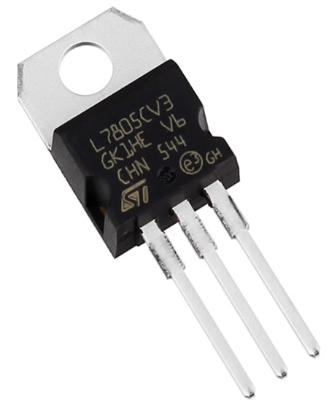
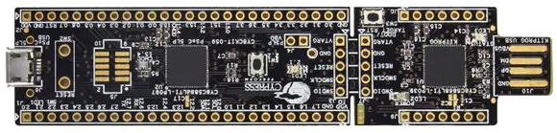
Hardware
Components
Accelerometers
9V battery
Bluetooth module
9 to 5 voltage regulator
PSoC microcontroller
M. Alfonzo, C. Canavate, P. Franke

Slide 5
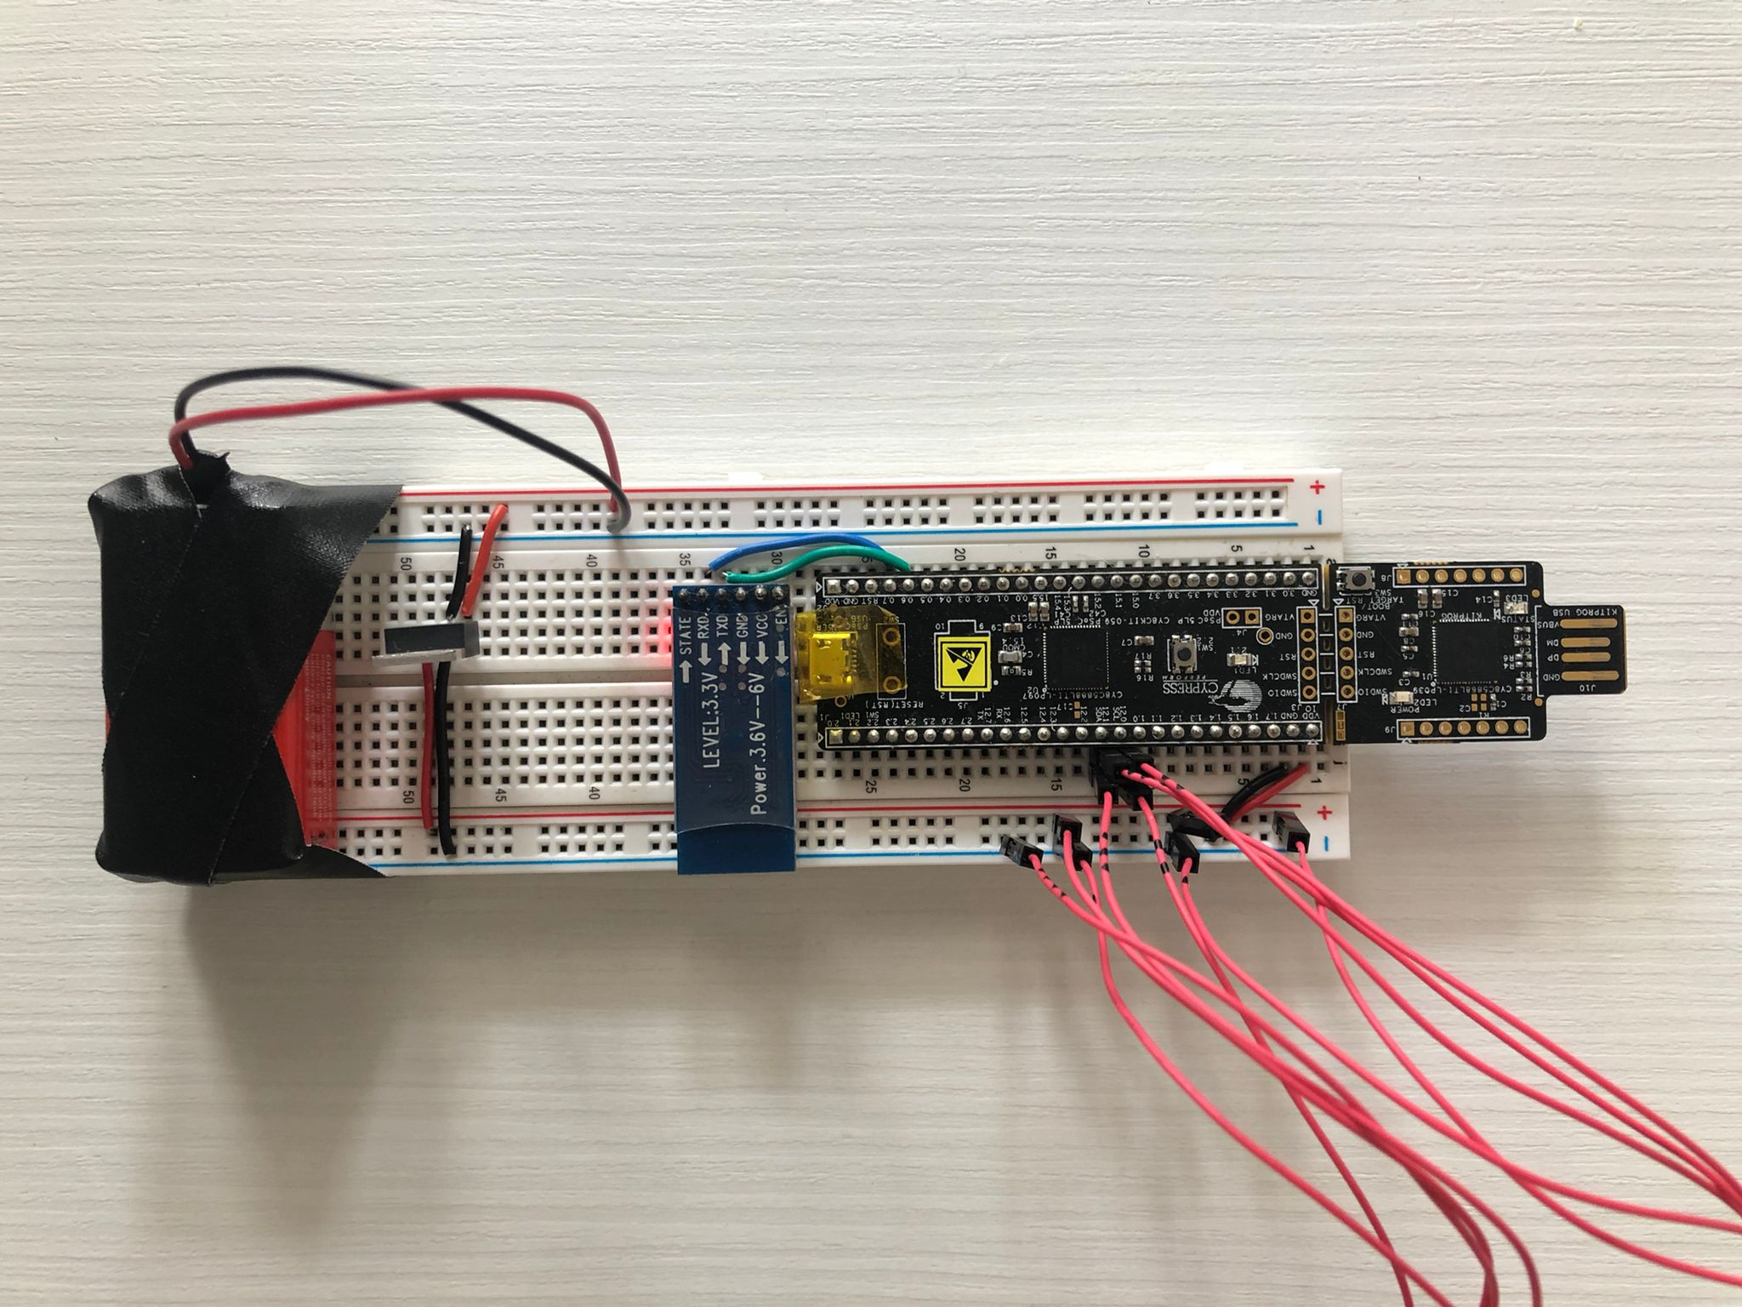
Hardware – Breadboard
M. Alfonzo, C. Canavate, P. Franke

Slide 6
Hardware – Breadboard
External wires connecting 2 accelerometers
9V Battery
Bluetooth module
Voltage regulator
9V to 5V
M. Alfonzo, C. Canavate, P. Franke

Slide 7
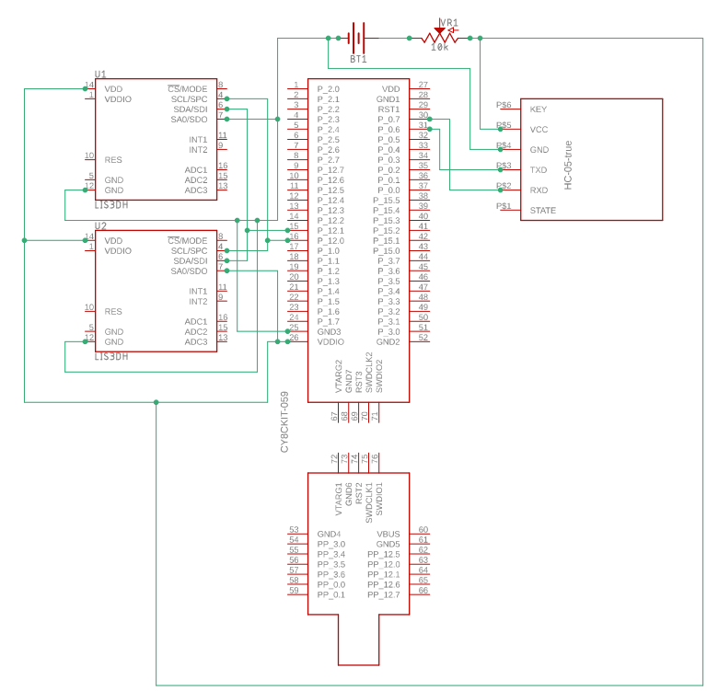
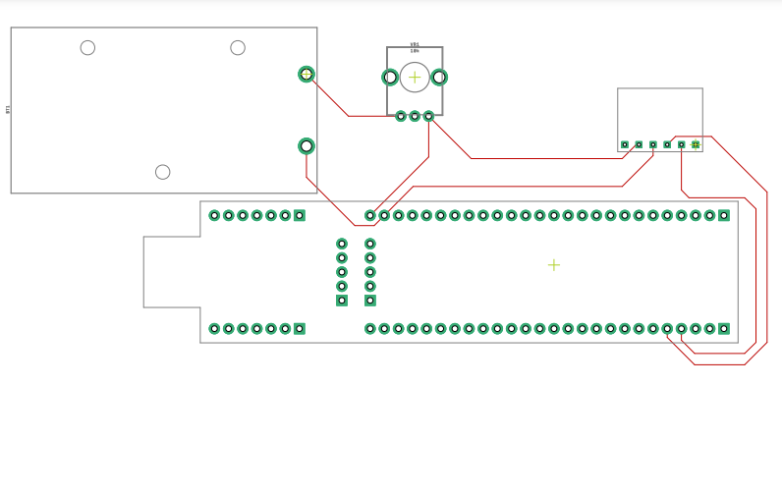
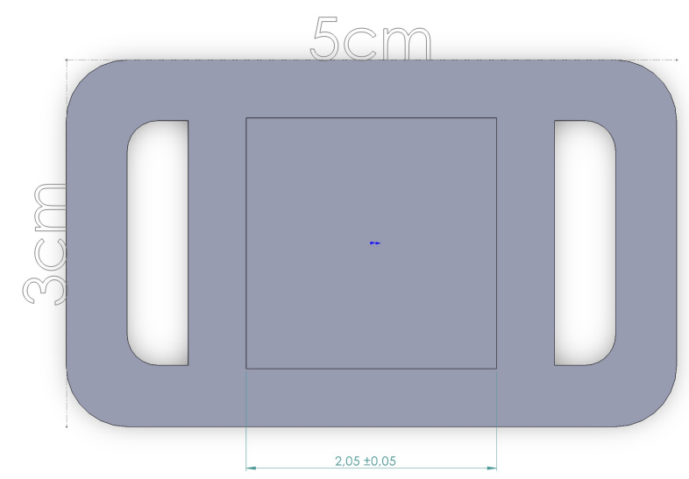
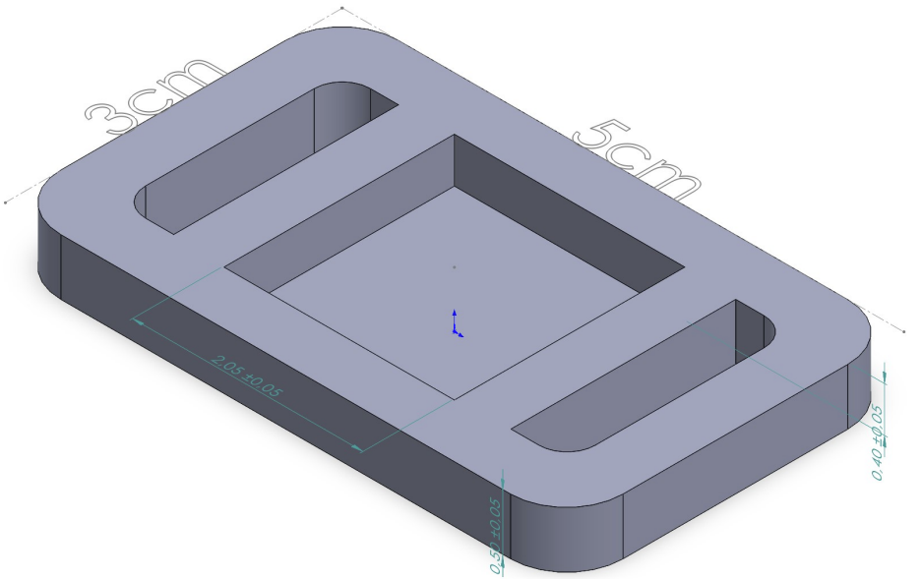
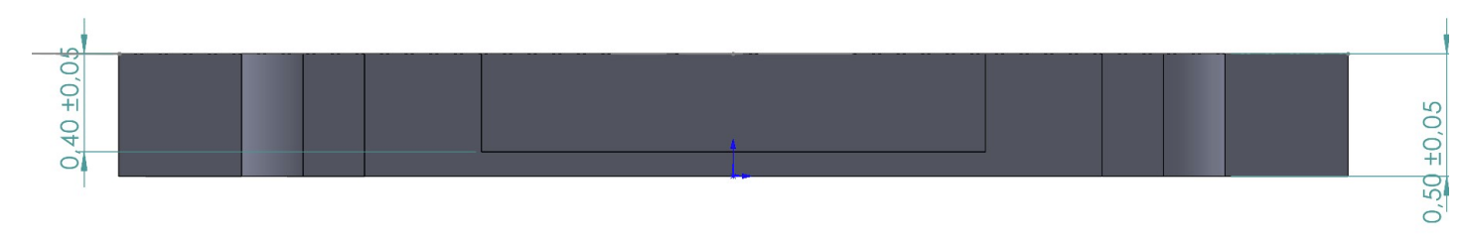
PCB & Casing
M. Alfonzo, C. Canavate, P. Franke

Slide 8
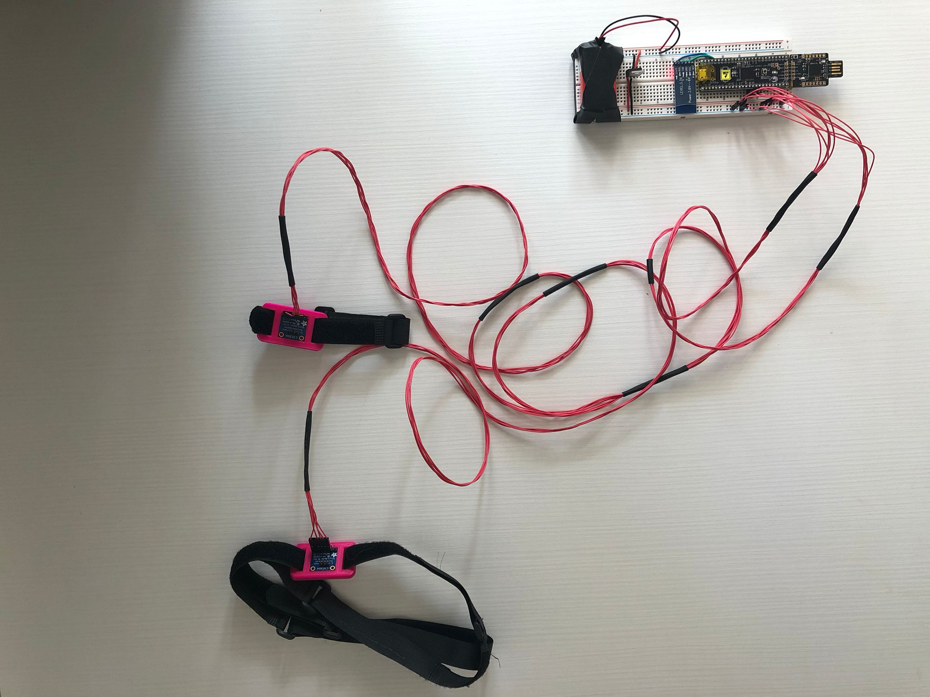
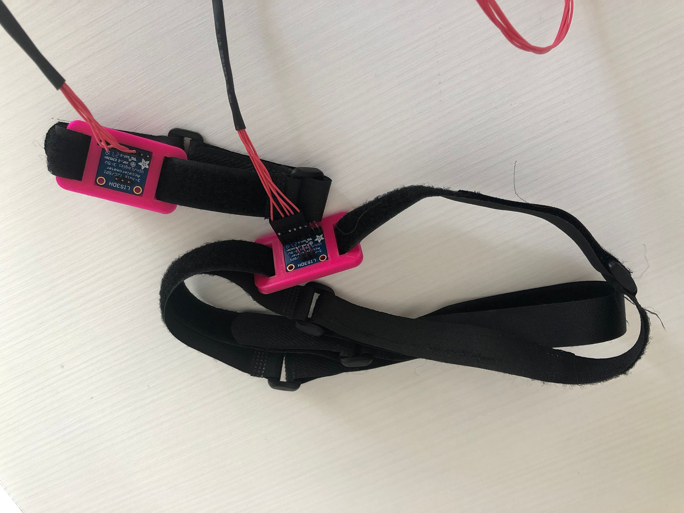
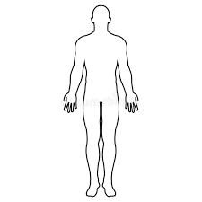
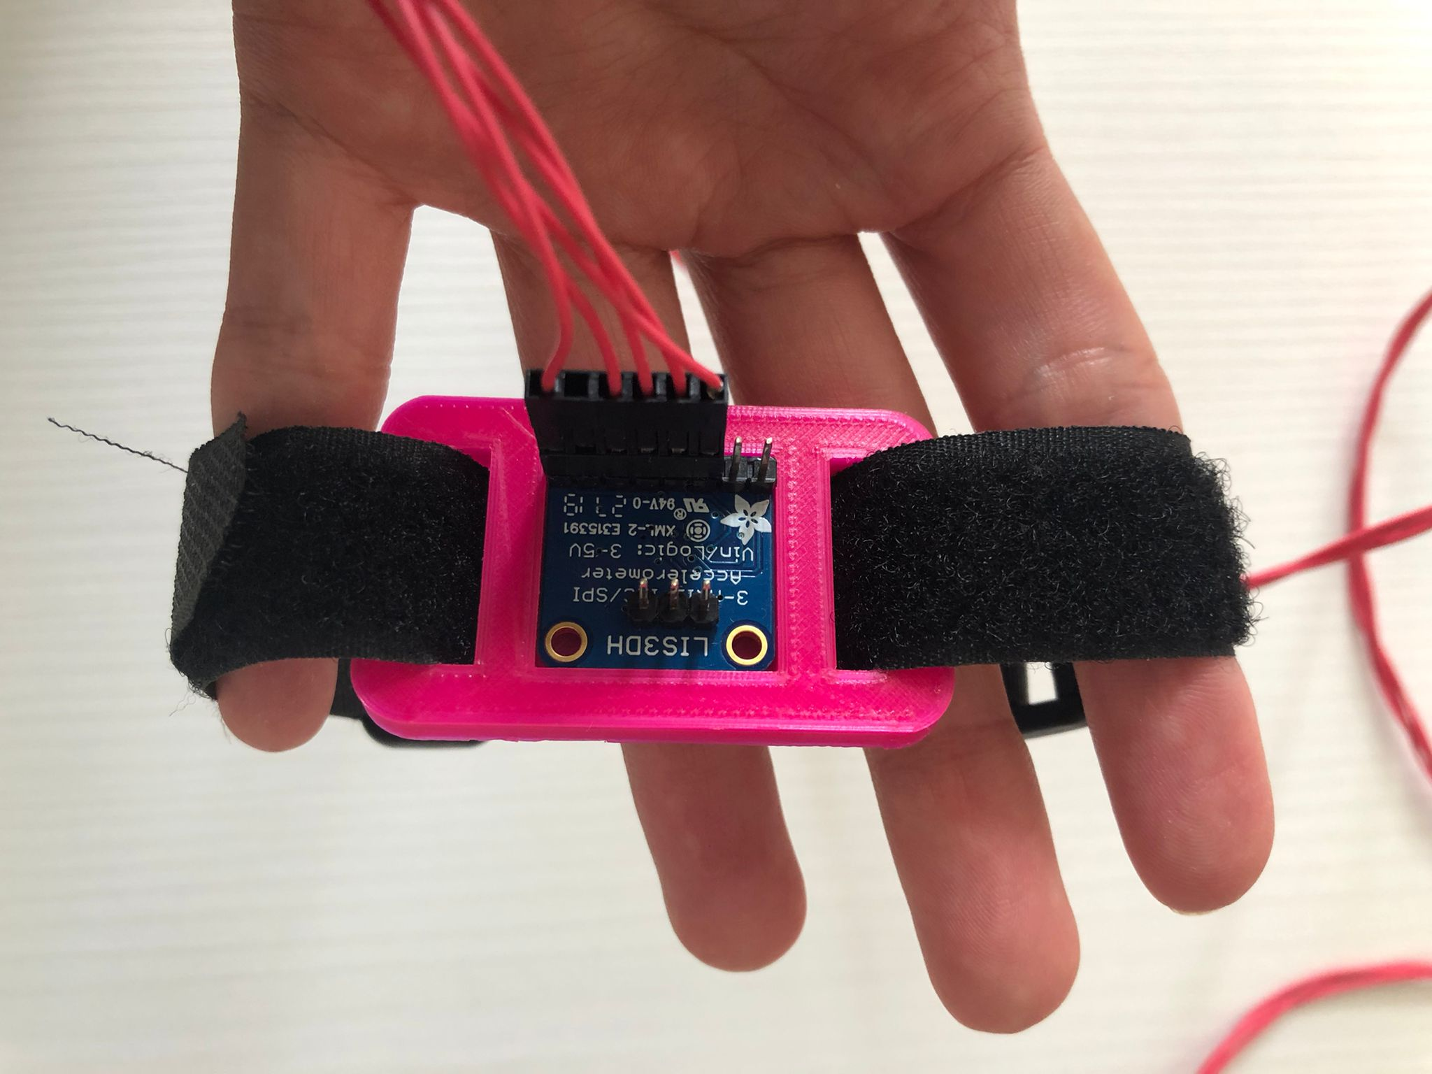
Hardware – Wearables
Chest
Ankle
2-meter long wires
M. Alfonzo, C. Canavate, P. Franke

Slide 9

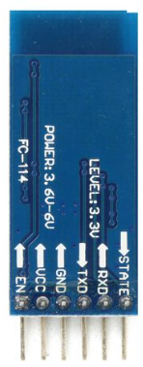


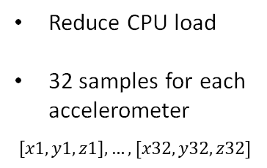
FIFO, I2C and Bluetooth communication
FIFO buffers
I2C communication
Bluetooth com.
Reduce CPU load
32 samples for each accelerometer
$$\left[x1, y1, z1\right], …, [x32, y32, z32]$$
Set ODR = 10Hz
Switch to FIFO mode
Get 32 samples for each accelerometer
Send averaged data – string message
Baudrate 9600 bps
$$S x_{chest}, y_{chest}, z_{chest}, x_{ankle}, y_{ankle}, z_{ankle} E$$
M. Alfonzo, C. Canavate, P. Franke

Slide 10


Data acquisition protocol
Body placements
Data acquisition
Place 1st accelerometer
on top of the chest
At least 10 people
Orientation
1 minute each position
Place 2nd accelerometer on the left ankle, on top of the external malleolus
20 seconds to switch position
M. Alfonzo, C. Canavate, P. Franke

Slide 11
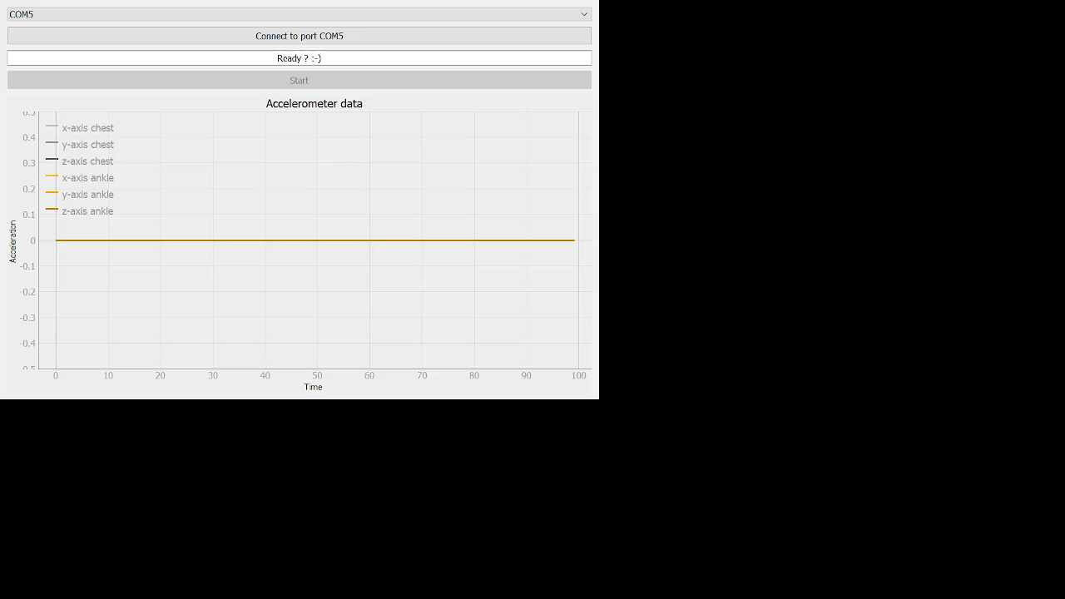
GUI for data acquisition and visualization
M. Alfonzo, C. Canavate, P. Franke

Slide 12
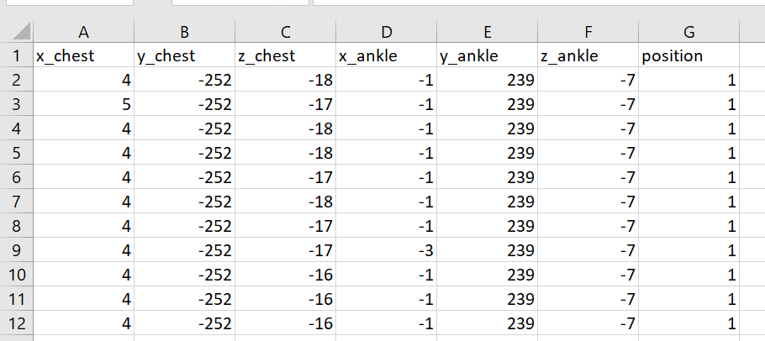
Datasets
target
11 datasets
collected
features
M. Alfonzo, C. Canavate, P. Franke

Slide 13
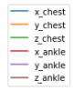
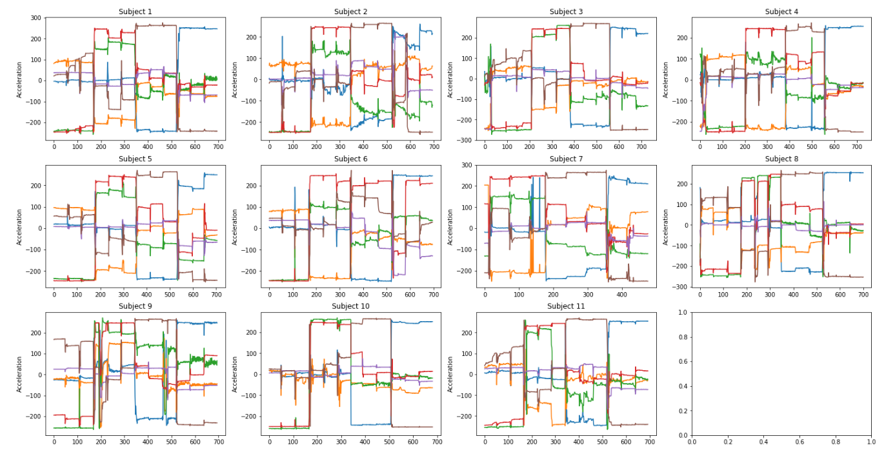
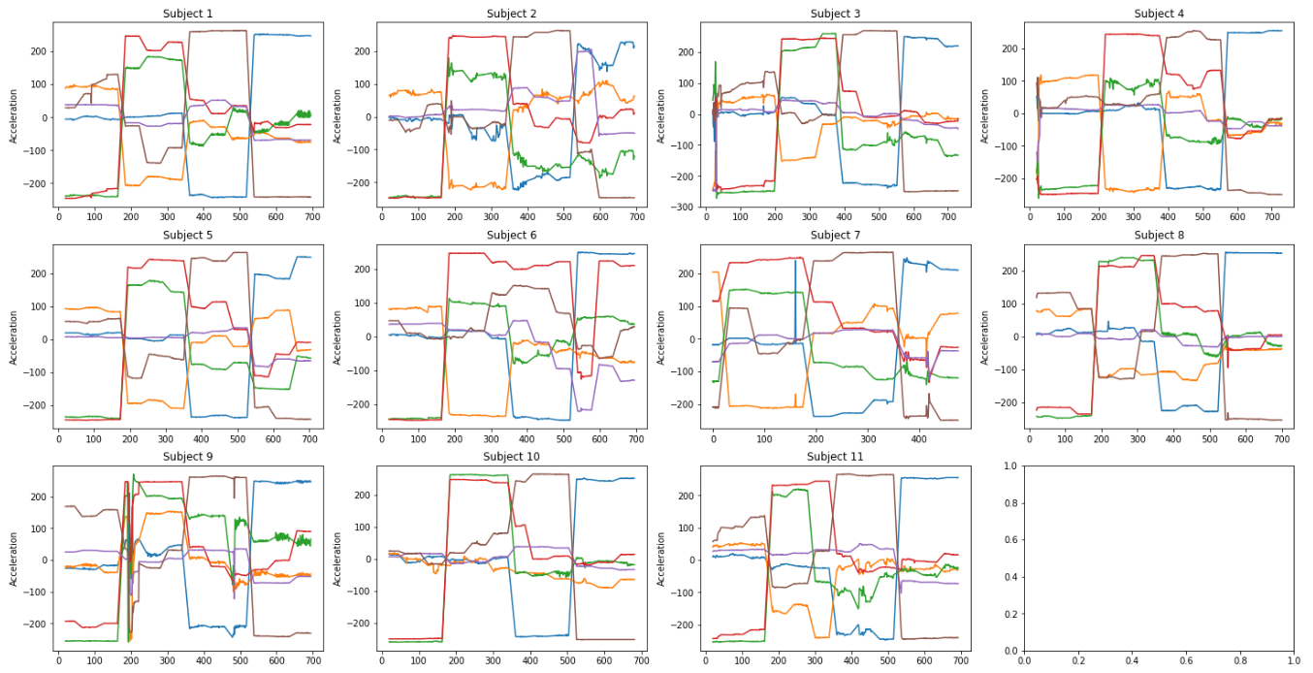
Machine Learning – Data visualization & cleaning
Raw data (before data cleaning)
Data after removing the first 20 transient samples
M. Alfonzo, C. Canavate, P. Franke

Slide 14
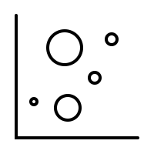

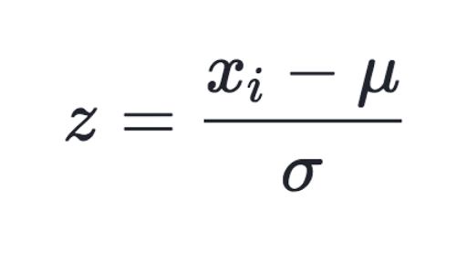
Machine Learning – Data preparation pipeline
Outlier removal
Train & test splitting
Standardization
Subjects and/or positions with erroneous data
Led to 10 people
4 females
6 males
70/30 split stratified on the subject IDs
Training set: 7 people
Test set: 3 people
Scaler learned on train set and applied to both train and test sets
3 datasets
created
Dataset 1 - All the samples for the 6 coordinates
Dataset 2 - Averages, the min and the max of the 6 coordinates
Dataset 3 - Only the averages of the 6 coordinates
M. Alfonzo, C. Canavate, P. Franke

Slide 15
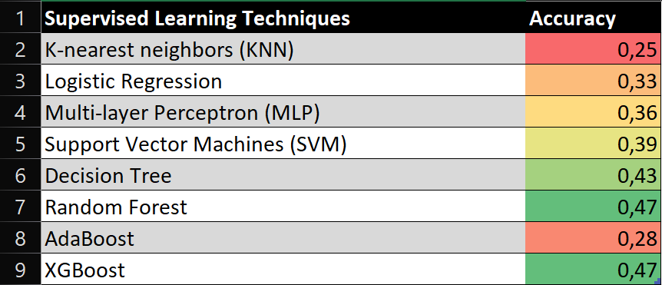
Machine Learning – Overview of evaluated techniques
M. Alfonzo, C. Canavate, P. Franke

Slide 16
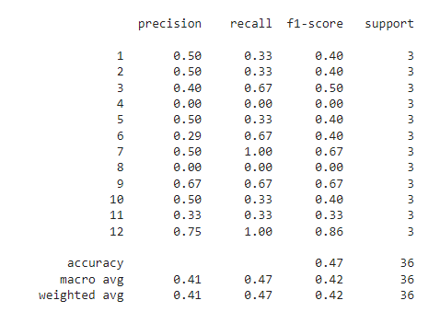
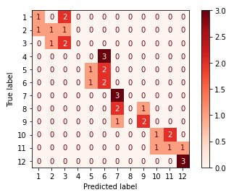
Machine Learning – Metrics and Results
Best for Supervised Learning: Random Forest
M. Alfonzo, C. Canavate, P. Franke

Slide 17
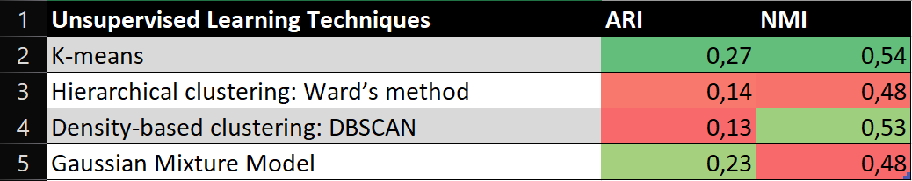
Machine Learning – Overview of evaluated techniques
ARI: Adjusted Rand Index
NMI: Normalized Mutual Information
M. Alfonzo, C. Canavate, P. Franke

Slide 18
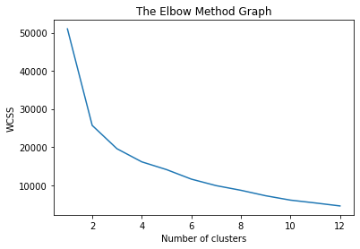
Machine Learning – Metrics and Results
Best for Unsupervised Learning: K-means
Adjusted Rand Index: 0.27
Normalized Mutual
Information: 0.54
WCSS: Within cluster sum of squares
M. Alfonzo, C. Canavate, P. Franke

Slide 19
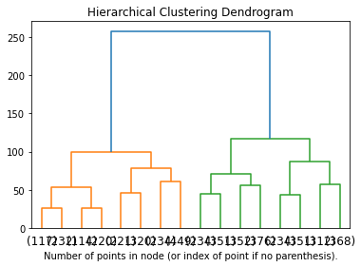
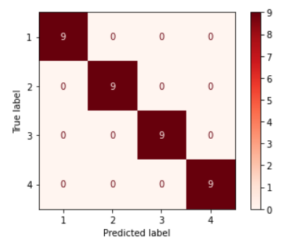
Machine Learning – Grouping to Master positions
Accuracy: 100%
M. Alfonzo, C. Canavate, P. Franke

Slide 20


Future developments
Use additional sensors to distinguish between very similar positions
Gather more data (subjects & sampling conditions)
Implement real-time sleeping position classifier
M. Alfonzo, C. Canavate, P. Franke

Slide 21
Project 5: Sleep Position Classifier
Massimo Alfonzo
Chloé Canavate
Patrick Franke
Tutor: Giulia Alessandrelli
Professor: Pietro Cerveri
Milan, 14 July 2022

